Slide 1
What AI can do?
MEETUP - #1
School of AI, Vellore.
C. Abdul Hakeem College of Engineering and Technology
Melvisharam, Vellore, Tamil Nadu

Slide 2
About me:
Research Scholar at VIT University
M.Tech. in CSE
B.E. in CSE from Dr. BAMU
Ambassador of AI6 community of Vellore
Area of research is Computer Vision

Slide 3
Before starting...
I’m not here to give you an expert lecture, this is a meet-up
People having same interests in a field come together
Discuss problems
Solutions
Share ideas
Networking
Collaborate
I’m still a learner
Do not judge me or my knowledge
Notes:
According to you what is AI?
Whats your understanding about AI?
Don’t be shy.
I would have said 2 vowels. Now comon

Slide 4
Artificial Intelligence
Merriam-Webster defines artificial intelligence this way: A branch of computer science dealing with the simulation of intelligent behavior in computers. The capability of a machine to imitate intelligent human behavior.
Notes:
Let me put this definition in other simple words
“Giving human like intelligence to machines”. That’s it. Simple. Now you might have got an idea what is AI.
Now lets move on

Slide 5
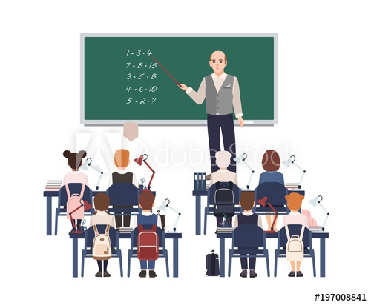
How we can make machines intelligent?
Example: Teacher –– Student / Parents –– Kid
Solution: Training and Data

Slide 6
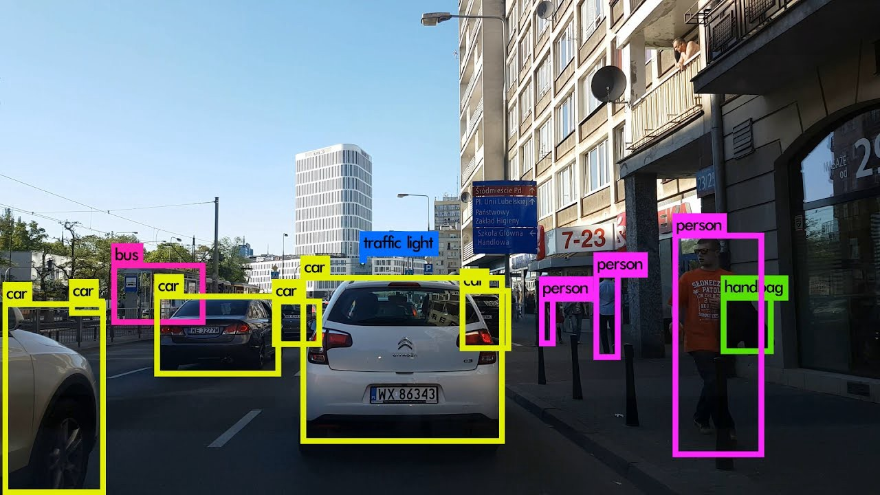
Self Driving Cars

Slide 7
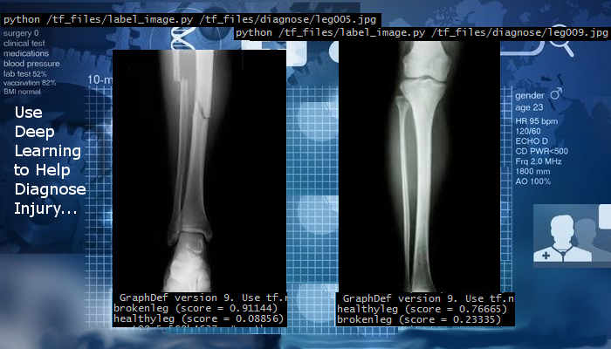
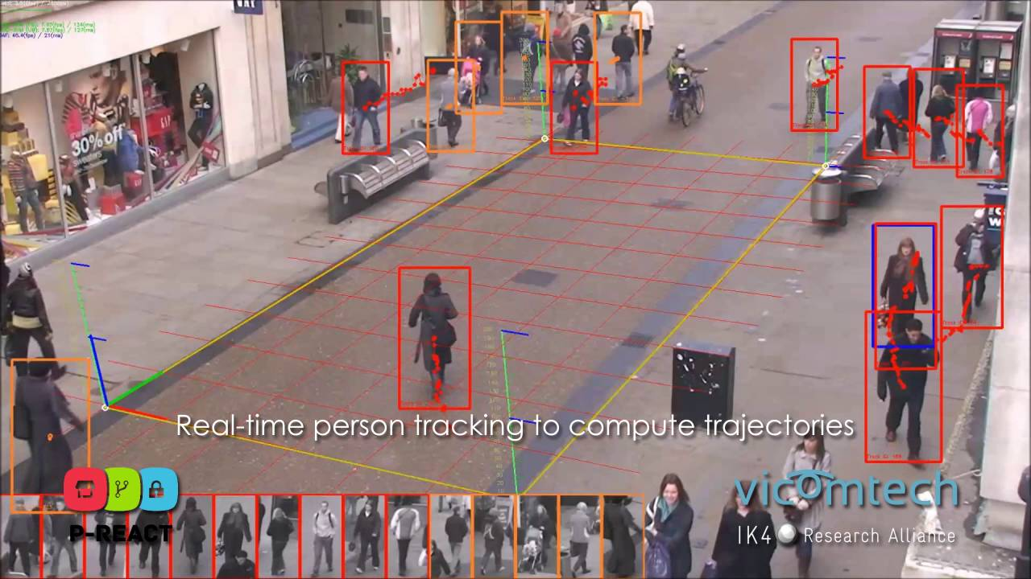
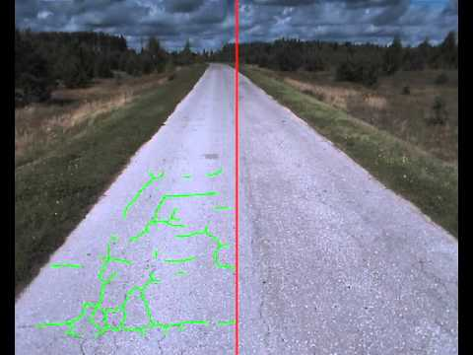
Other scenarios of Computer Vision
Detecting cancer cells, fracture
Drone delivery
Surveillance
Defect detection (crack detection on railway track)
Handwriting detection (Google Translate App)
Agriculture (harvesting crops faster than human, crop monitoring, predict various environmental impacts, PLANTIX app)
Game playing (Alpha Go, VizDoom)
Satellite Image analysis
https://cloud.google.com/vision/ (Live demo)

Slide 8
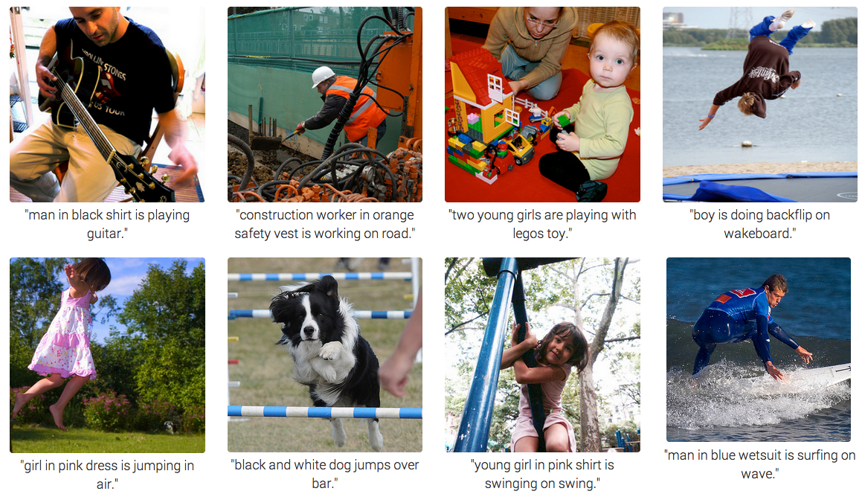
Image captioning

Slide 9
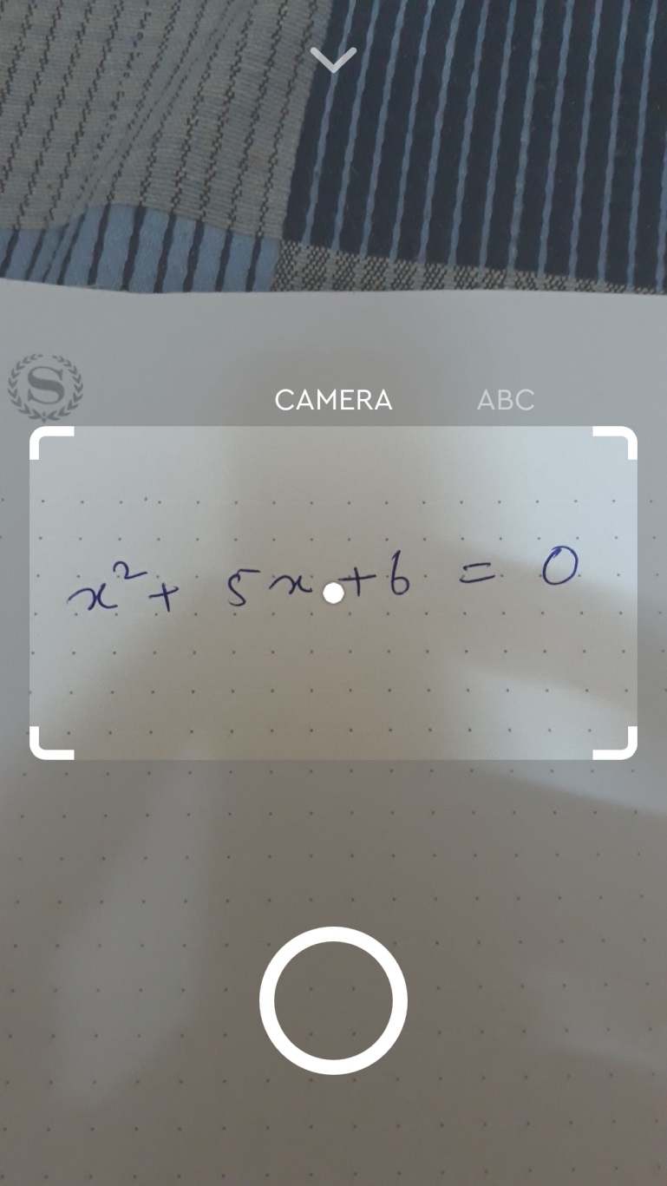
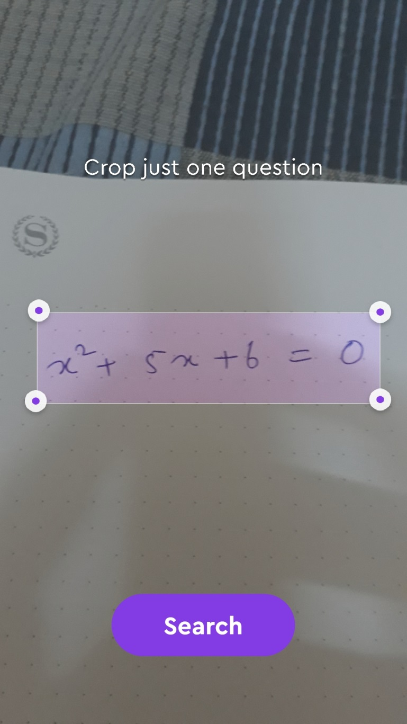
Socratic

Slide 10
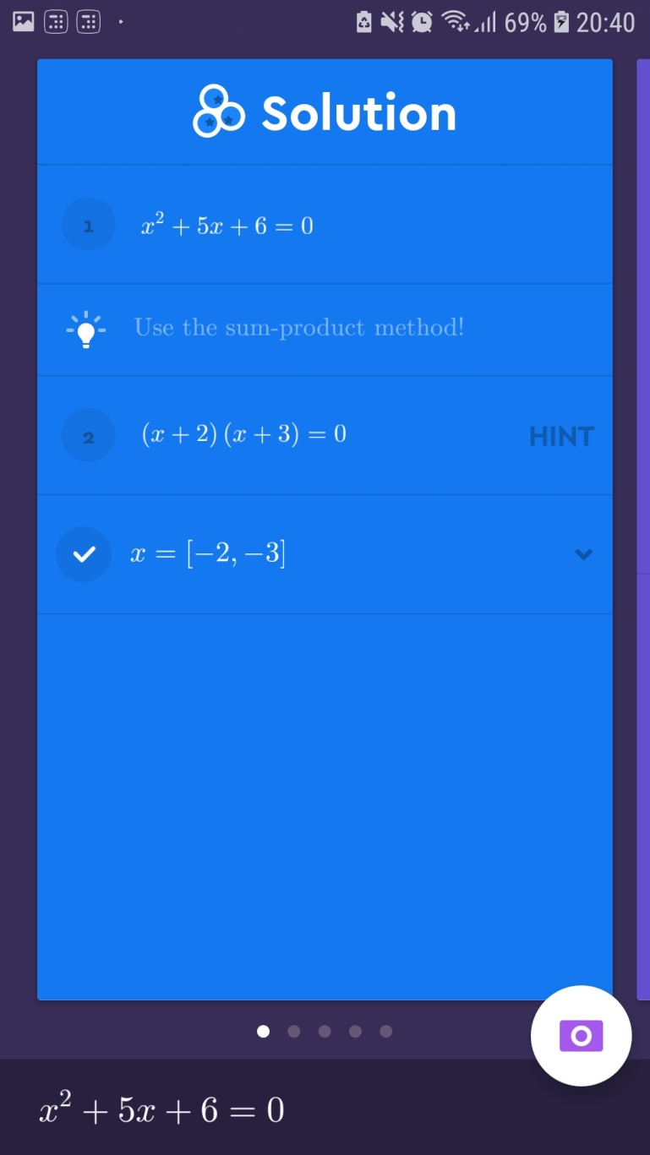
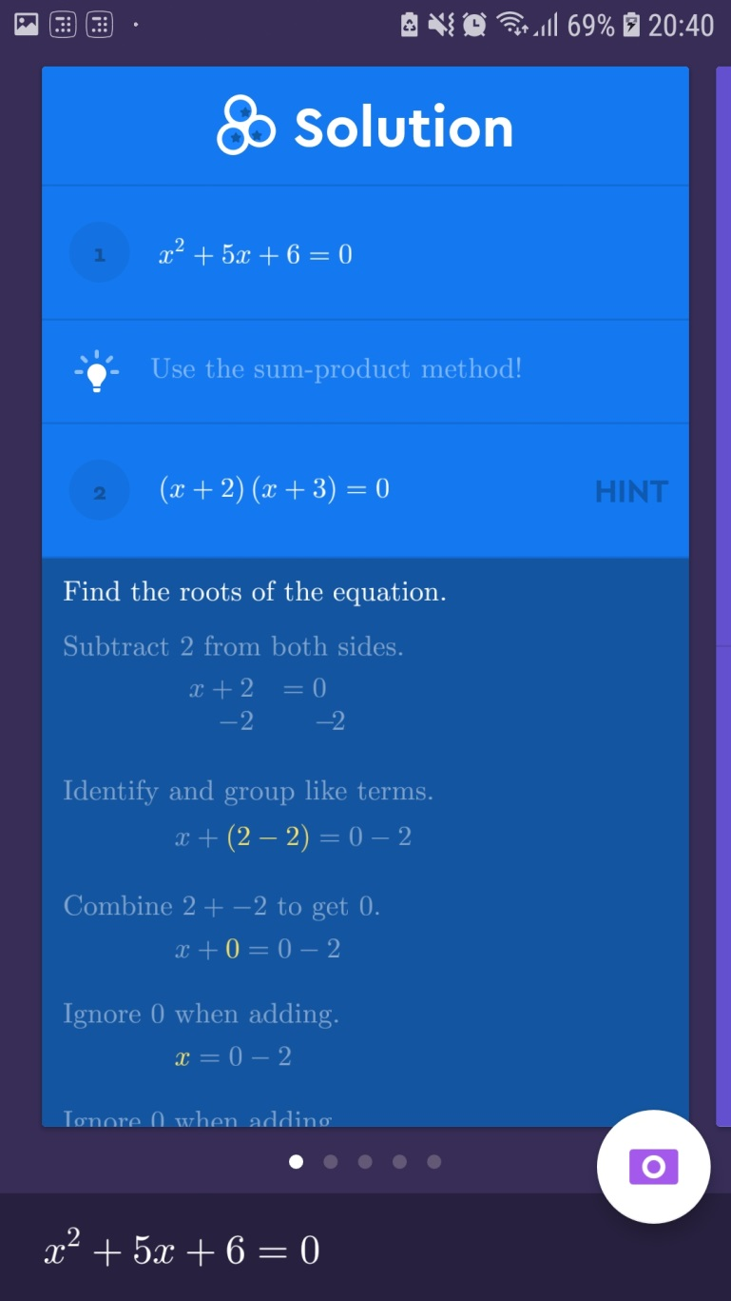

Slide 11
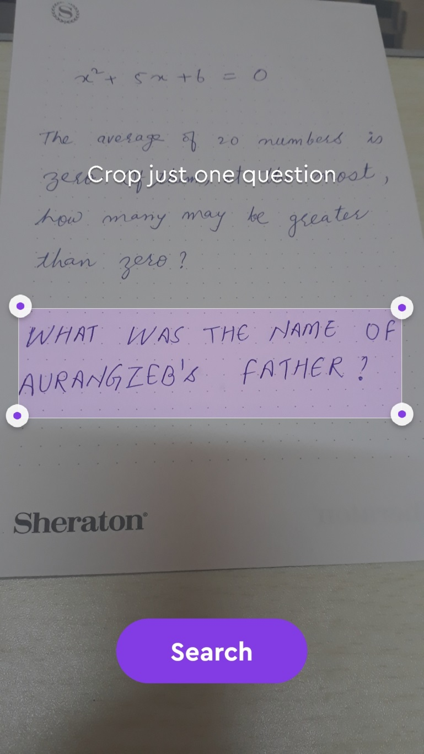
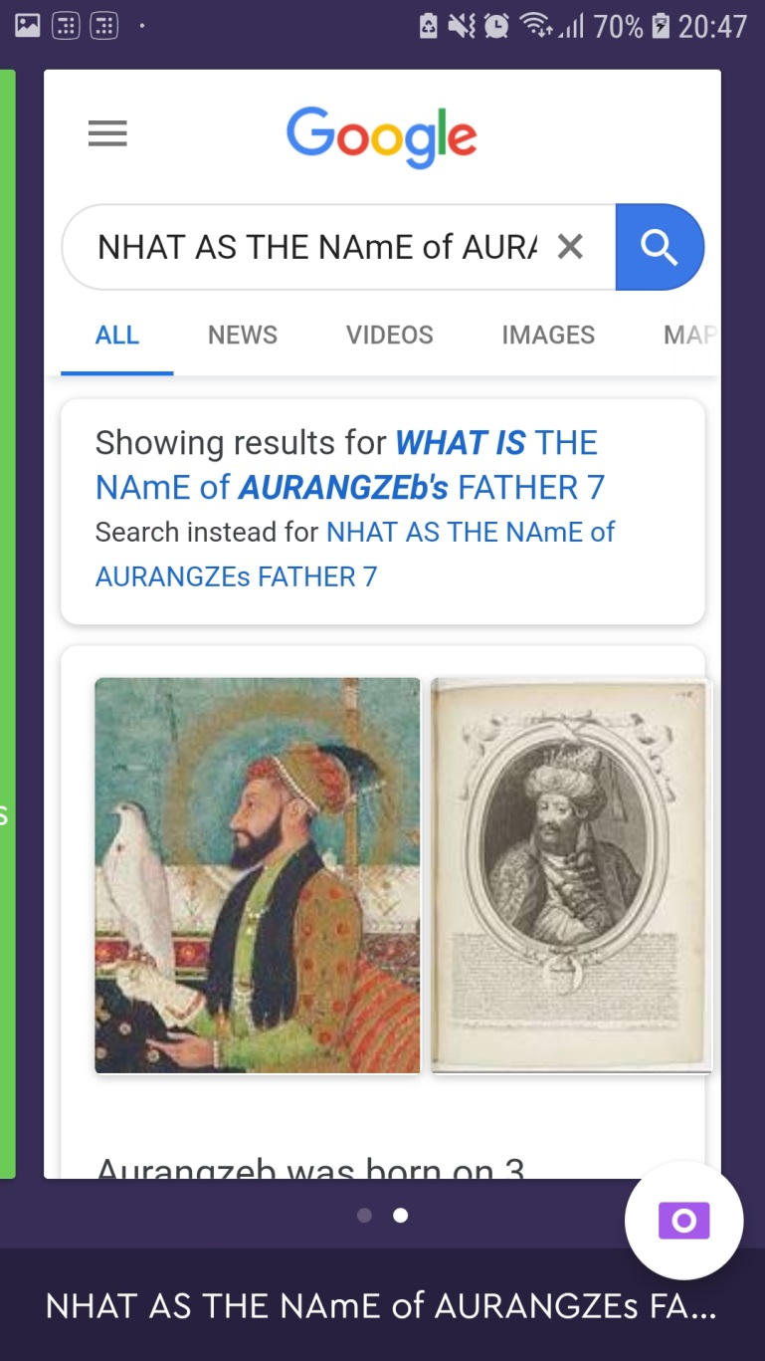

Slide 12
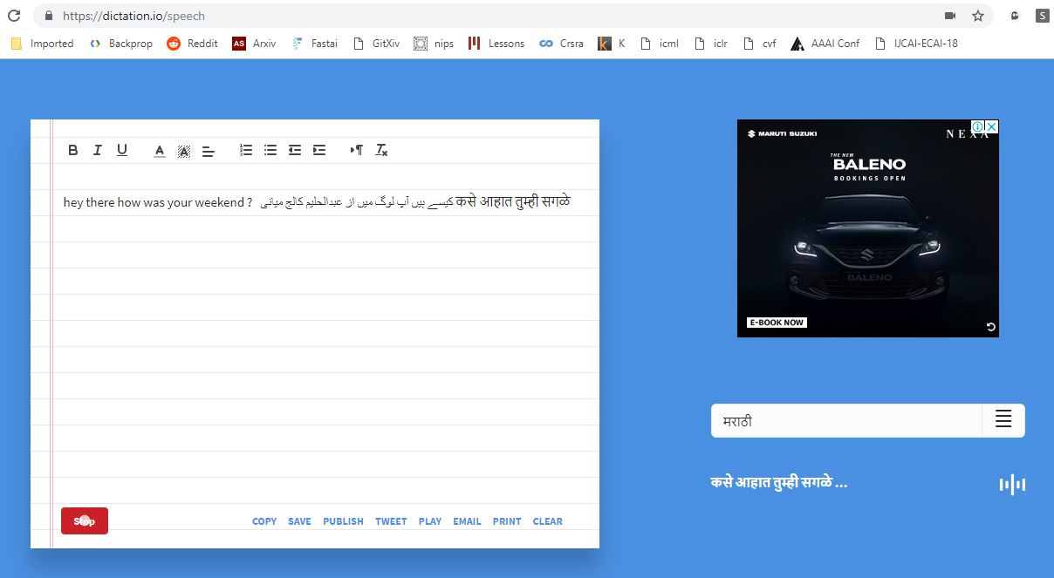
dictation.io

Slide 13
Other scenarios of speech to text
Air traffic controller
Google Assistant
Siri
IBM Watson

Slide 14
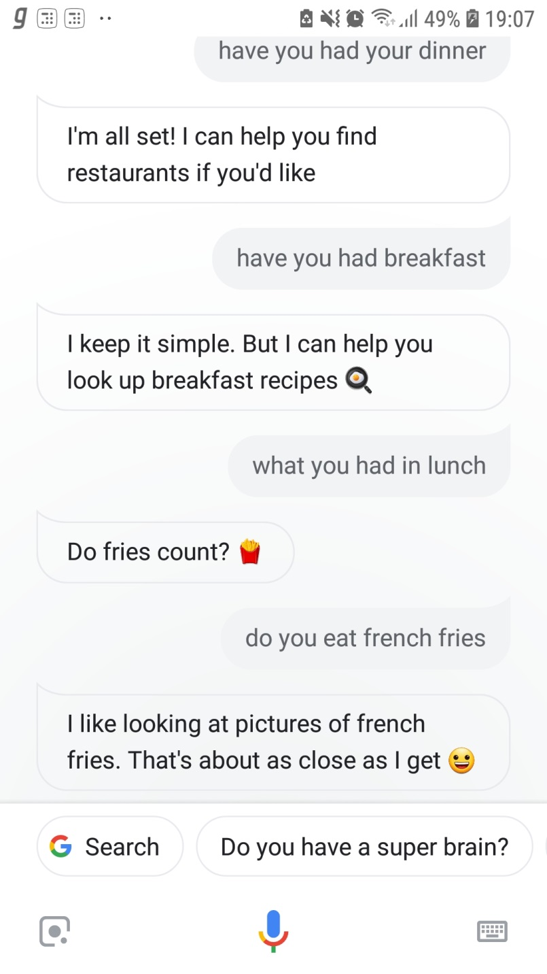
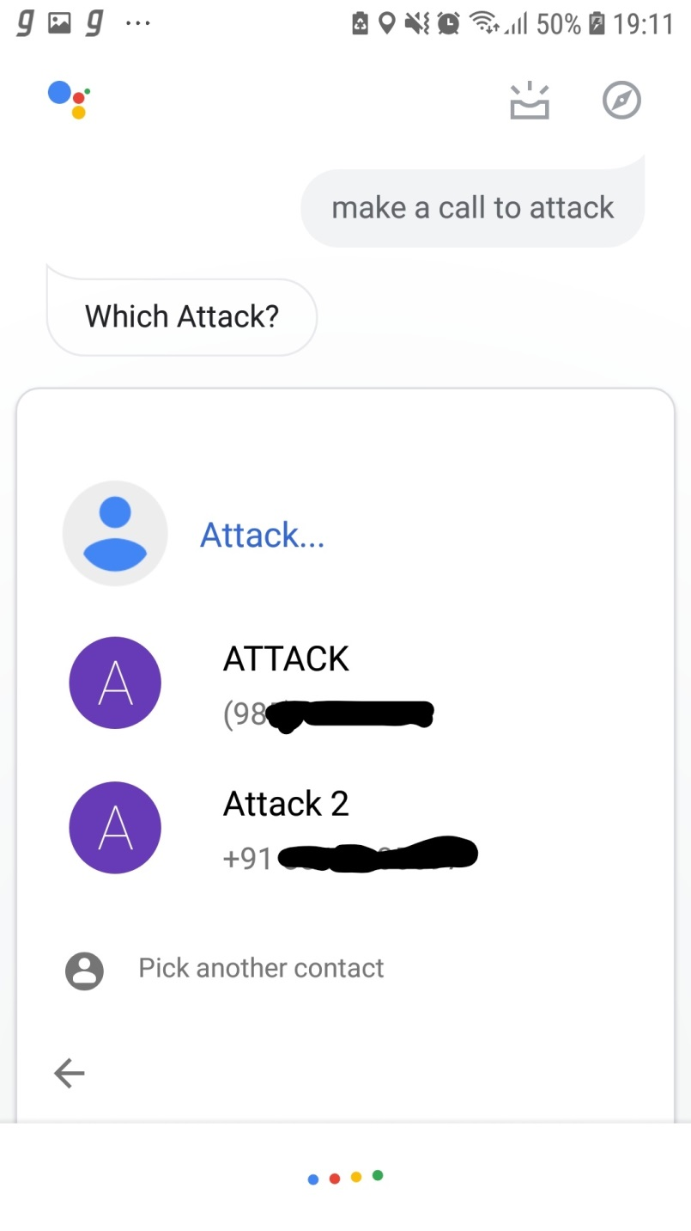

Slide 15
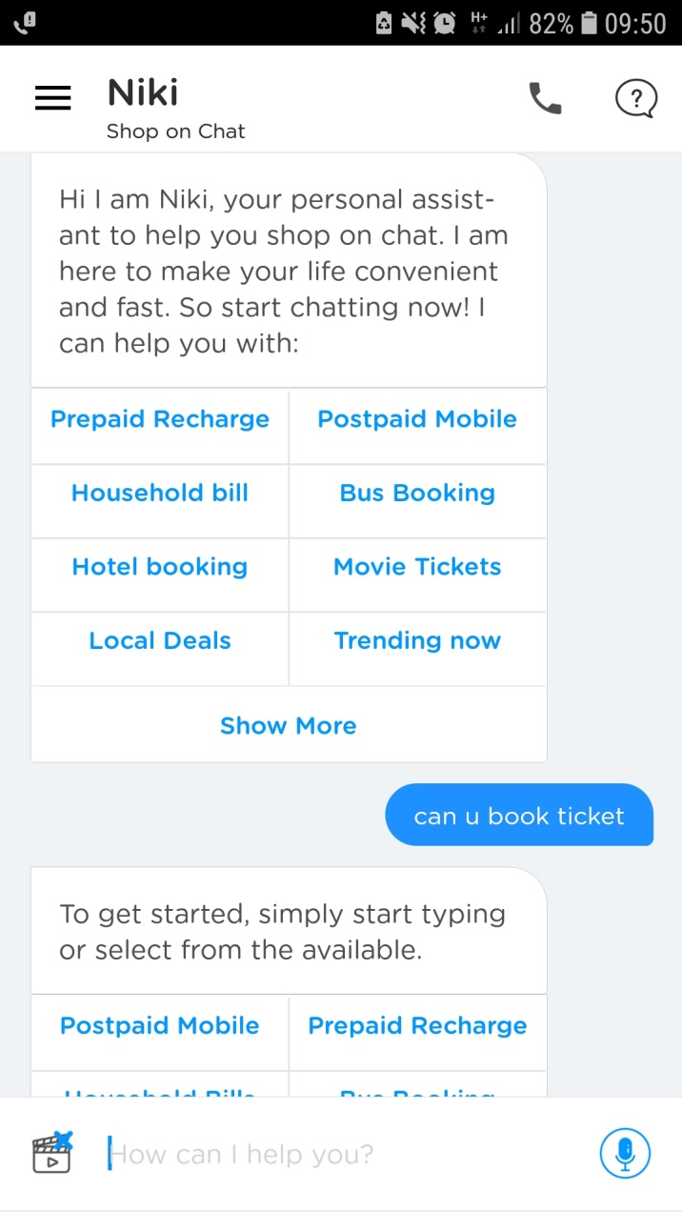
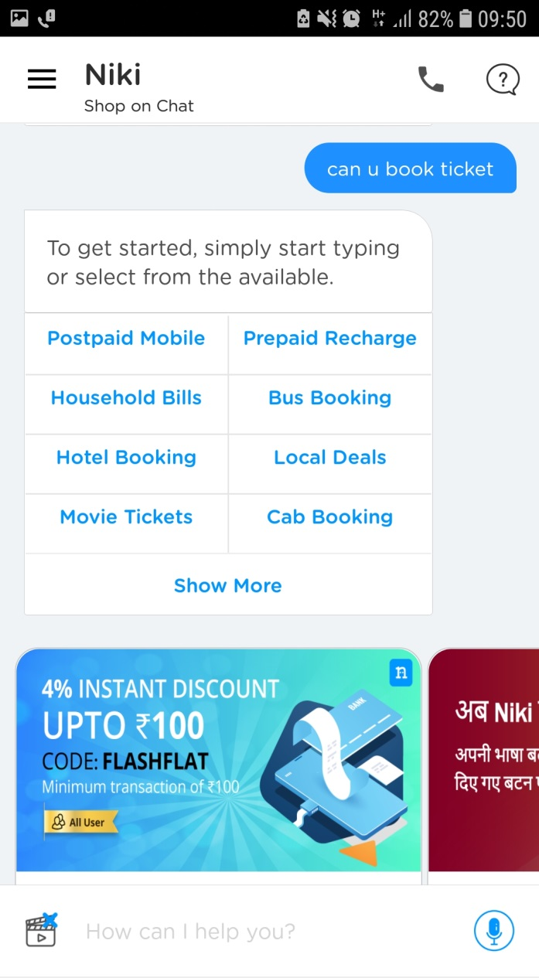
Niki.ai

Slide 16
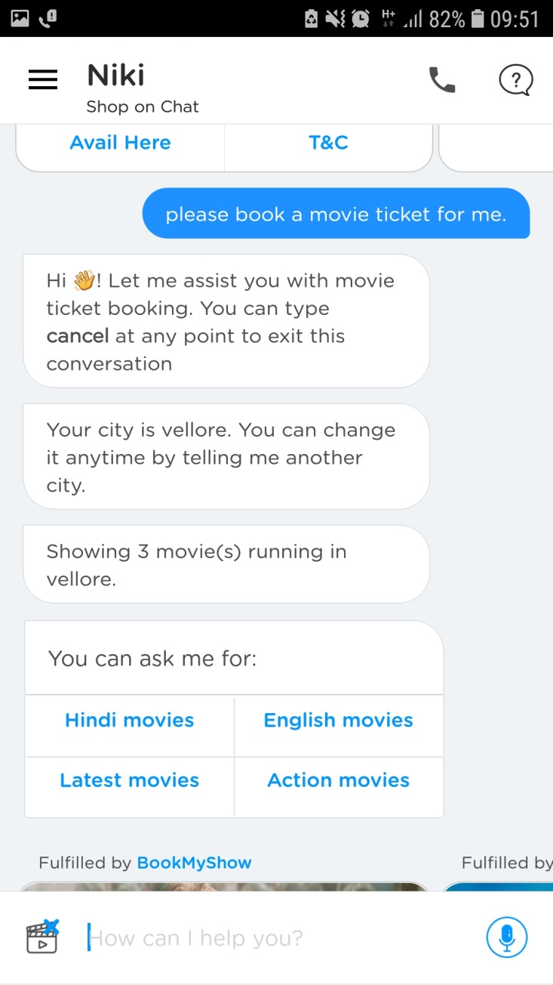
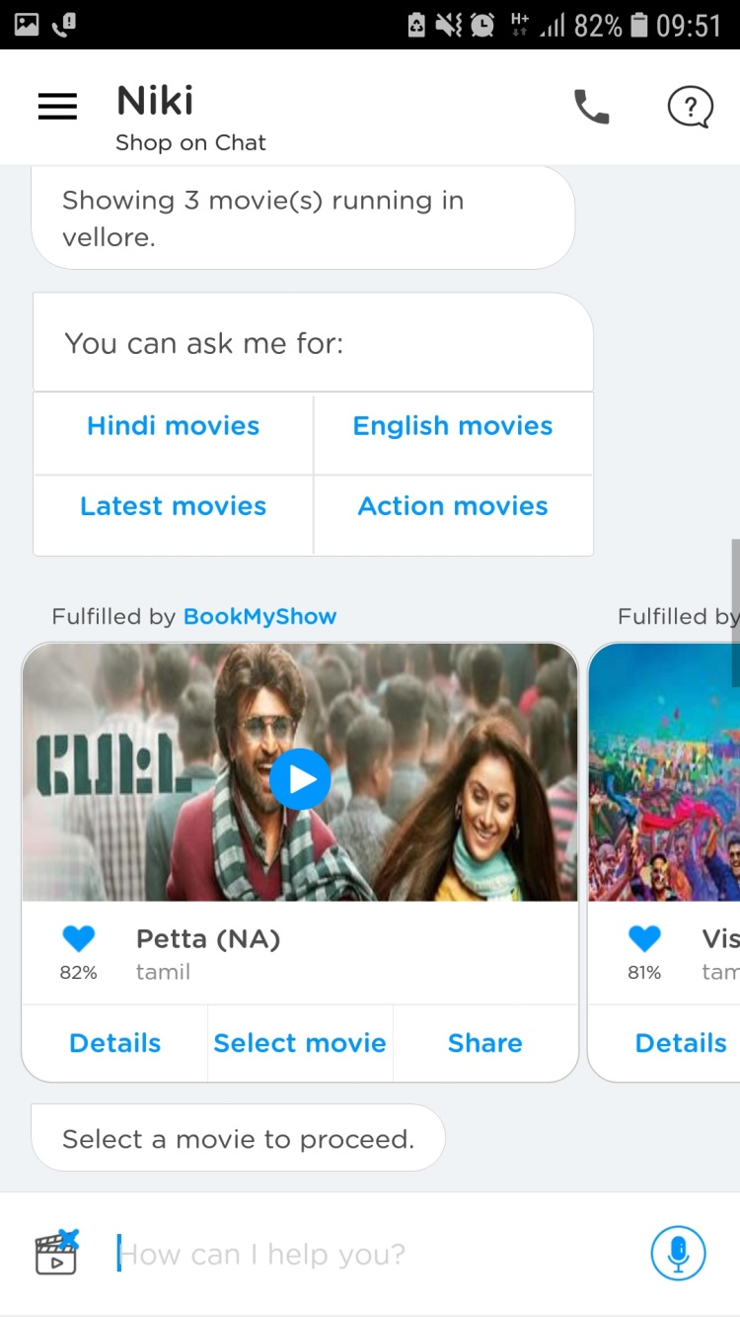

Slide 17
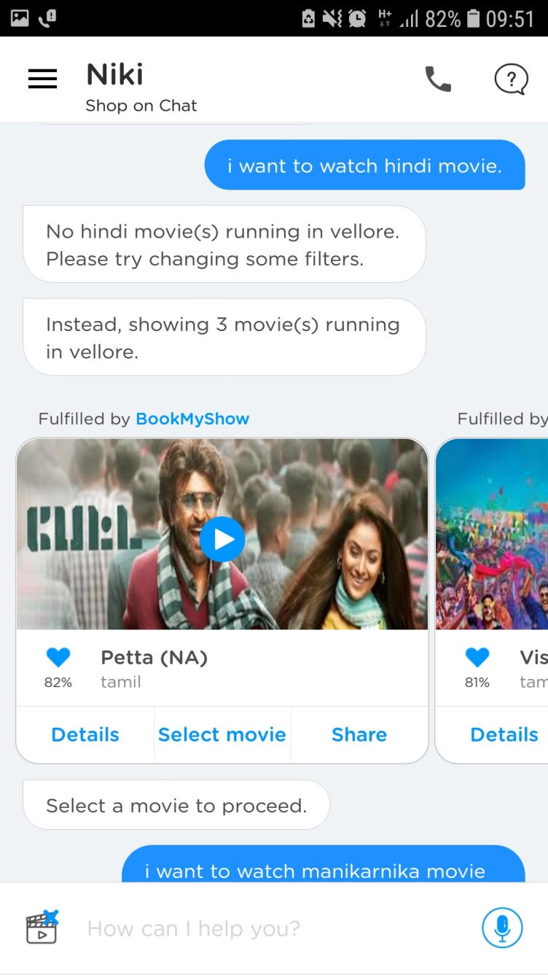
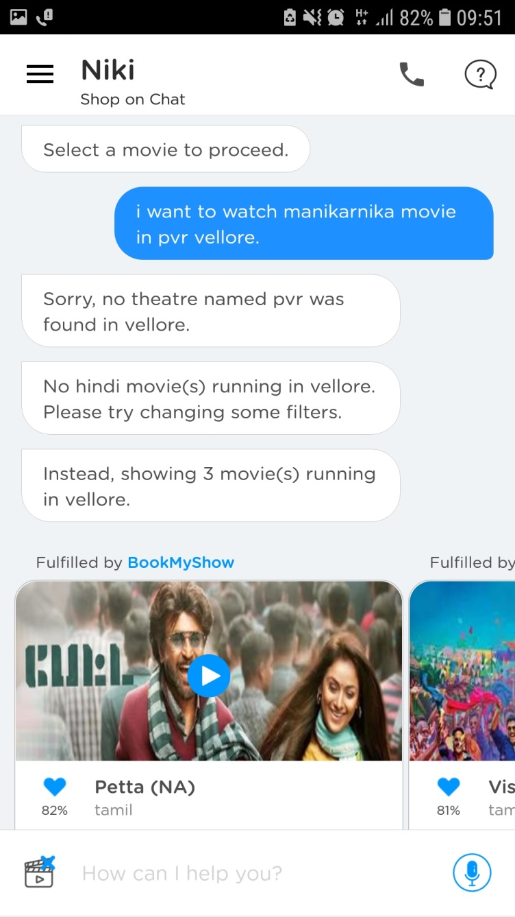

Slide 18
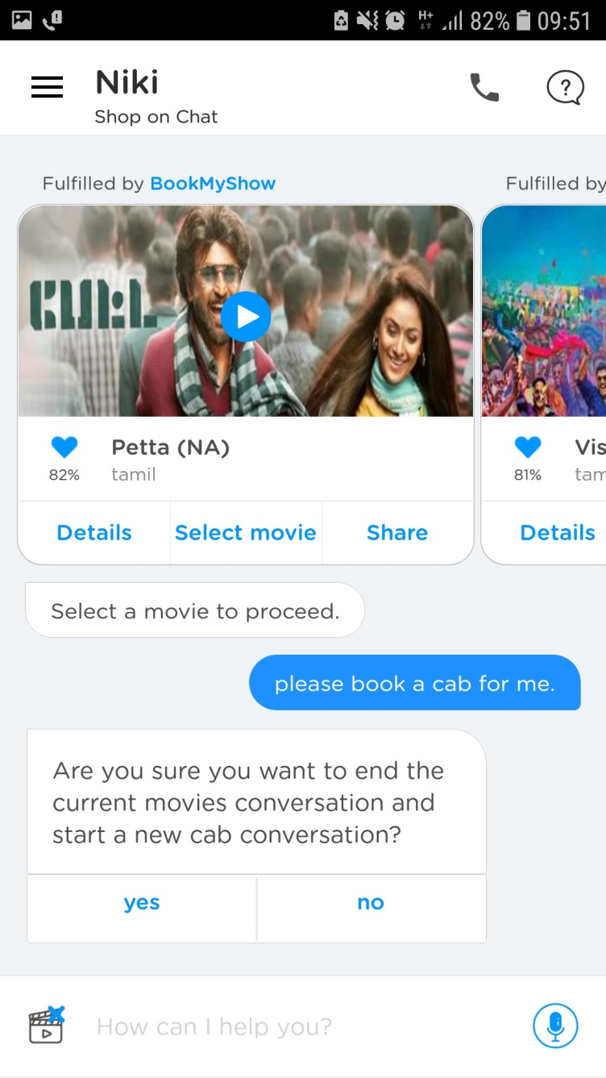
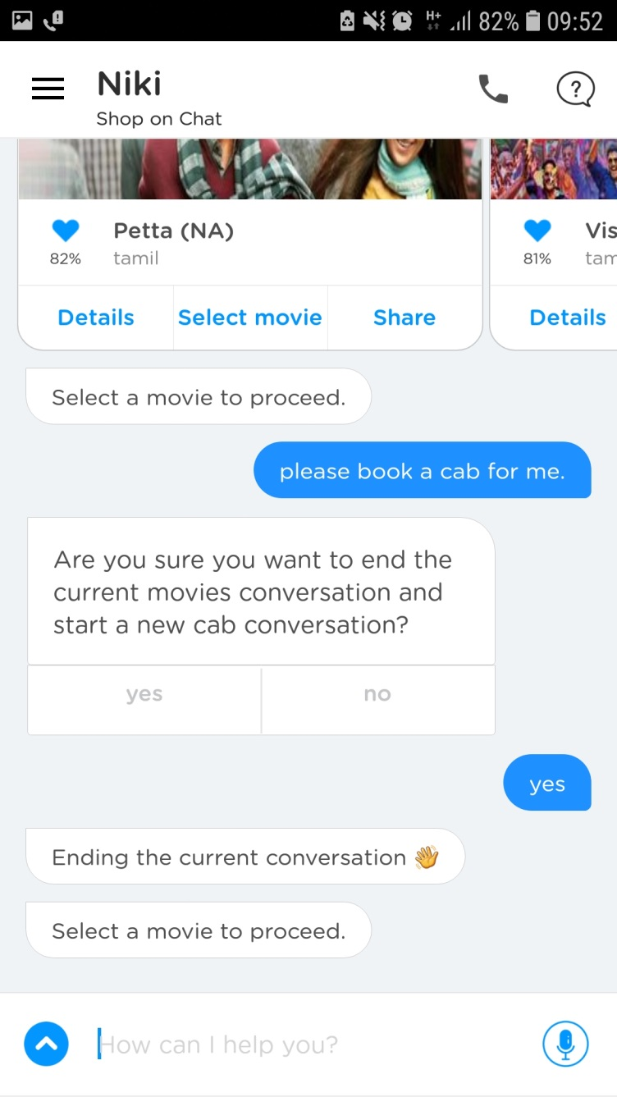

Slide 19
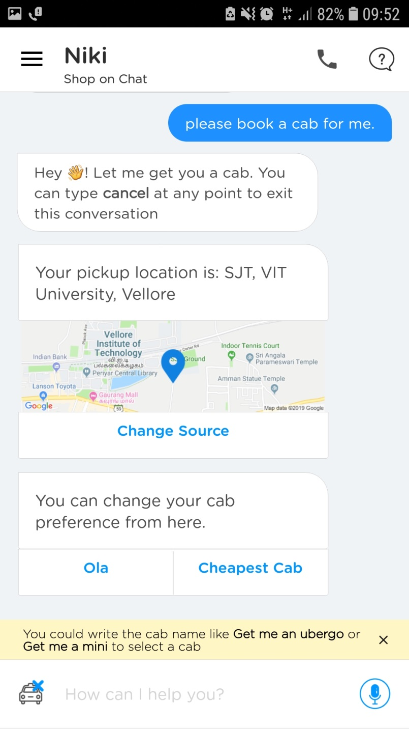
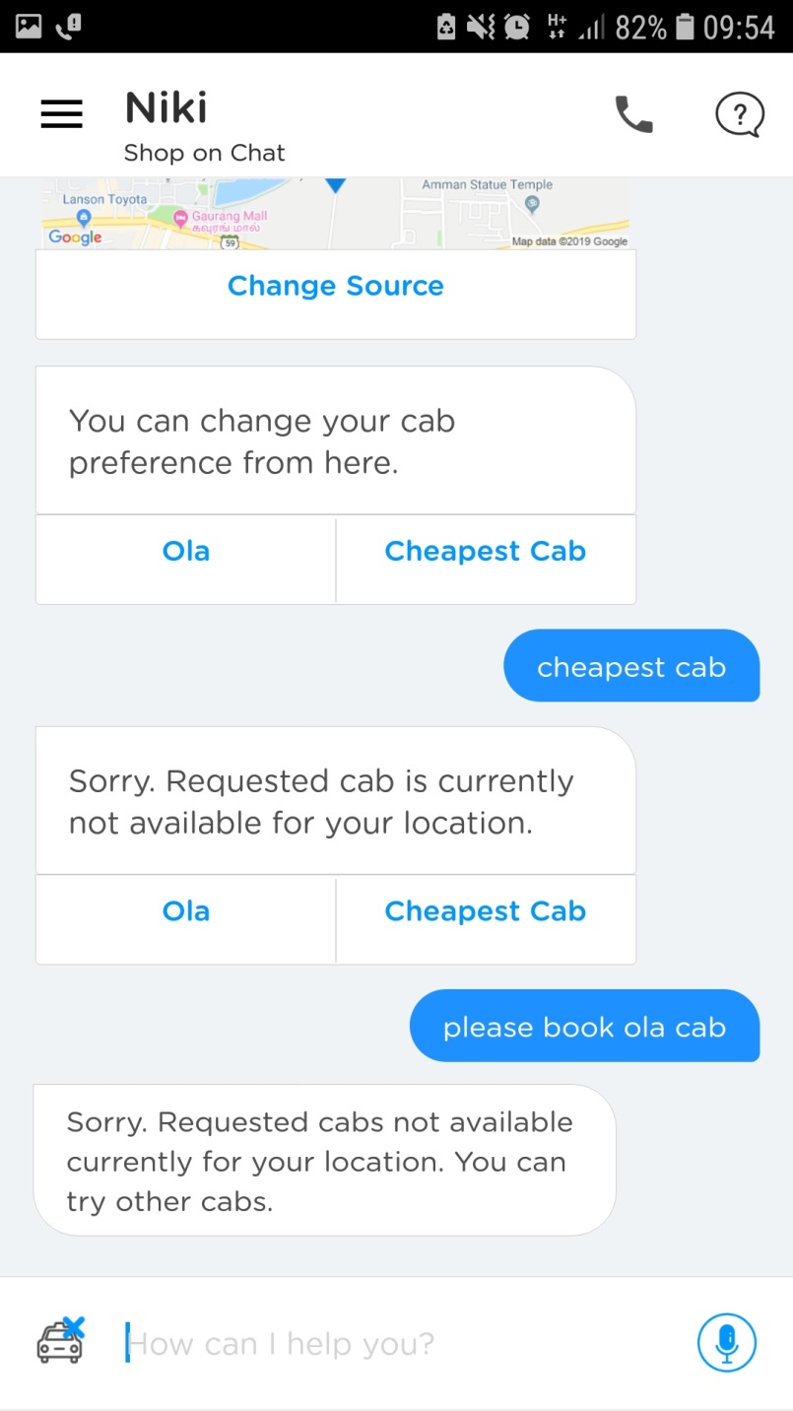

Slide 20
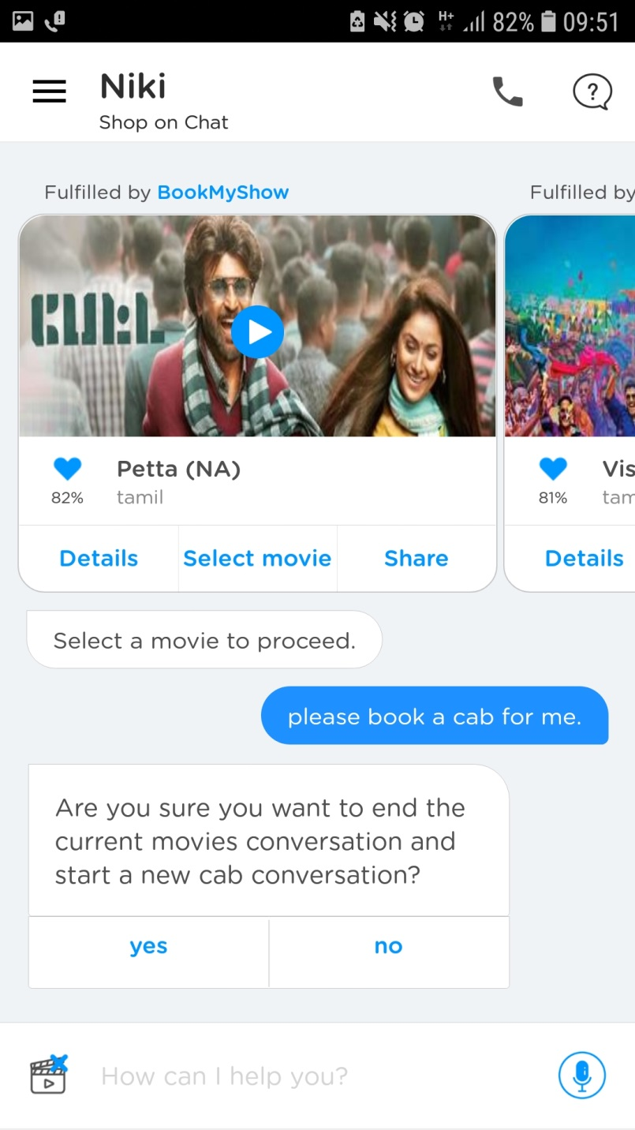

Slide 21
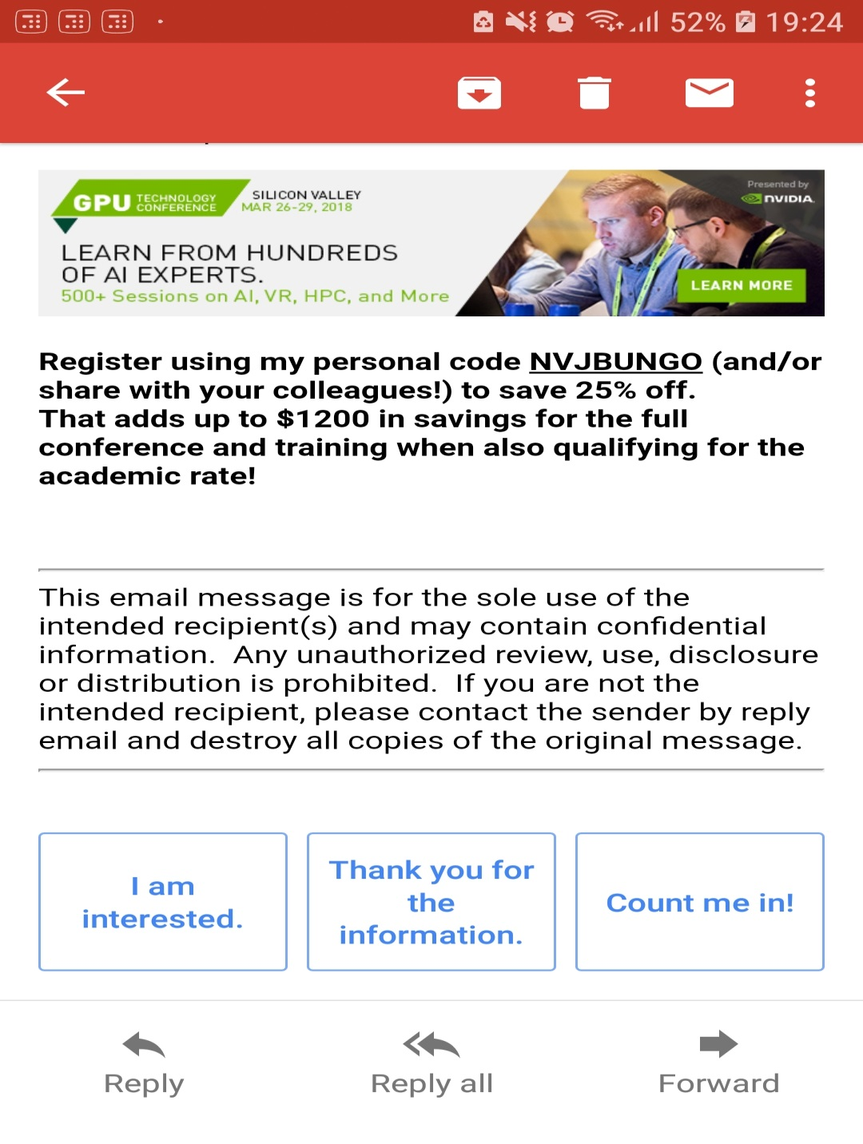

Slide 22
Other exciting applications of NLP
Gmail’s sentence completion suggestions
Generating news headlines
Summary of chapter or news article
Extracting important points
Google translate (lot of scope of improvements)
Facebook’s “Provide translation into Hindi”. (need to improve a lot)

Slide 23
Major industries where AI is being used
Aviation (Air Operation Division – AOD)
Finance (Market Analysis and data mining)
Government (Analyze Documents, Strategies)
Health Care (Mining medical records to provide useful info., design treatment plans)
Human resources and recruiting
Media (Face recognition, Analysis of video, recommendation)
E-commerce (Visual search, Chatbots, product recommendations)
Music (Classical music-AIVA, Background score)
News Writing (Sports Article based on team statistics, Finding fake news)
Online and telephone customer Services (Automated online assistants)
Transportation (Autonomous cars)
Notes:
Like 4th grade students can’t solve quadratic equations (exceptions might be there – have you guys seen Gifted movie? 2nd standard girls solves derivations ---- anyways) , but as student goes on to different grades, he solves difficult problems.
In similar way, right now AI can solve some of the problems and it will be more powerful in coming years.

Slide 24
Who really controls the world?
Deadly Weapons
Wealth
Corporate Media
AI (my prediction)

Slide 25
You are the future of AI
You’r gonna make everyone's life Luxurious.

Slide 26


